Slide 1
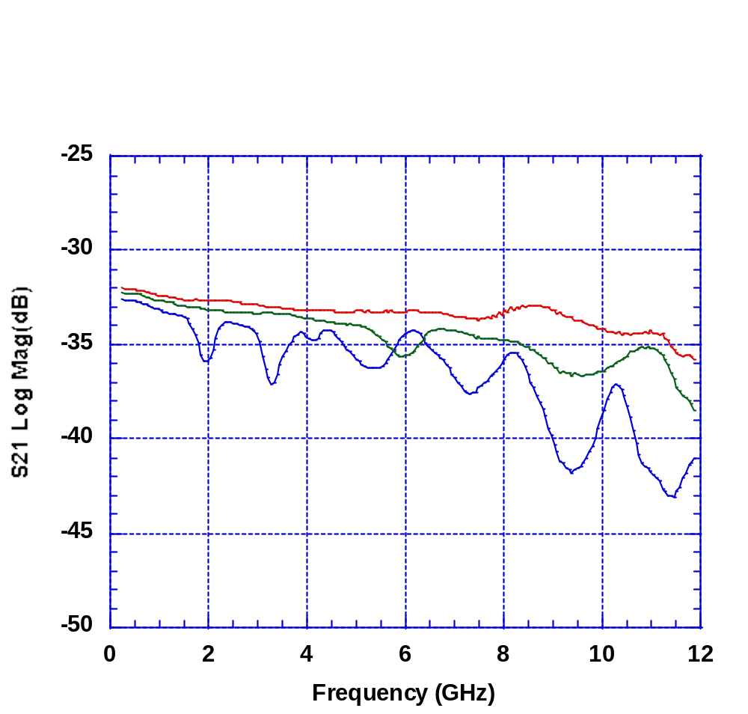
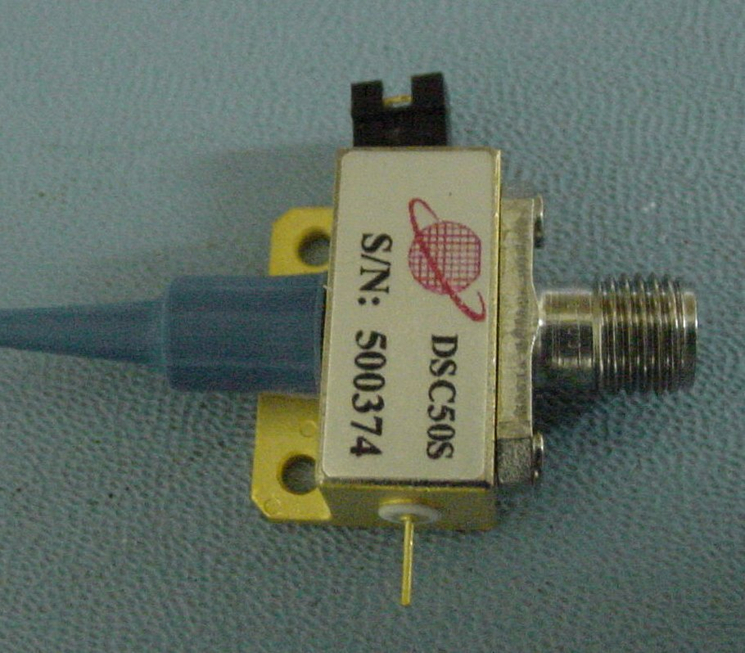
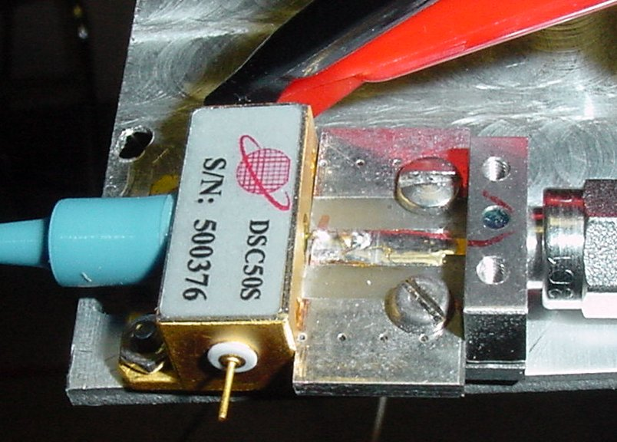
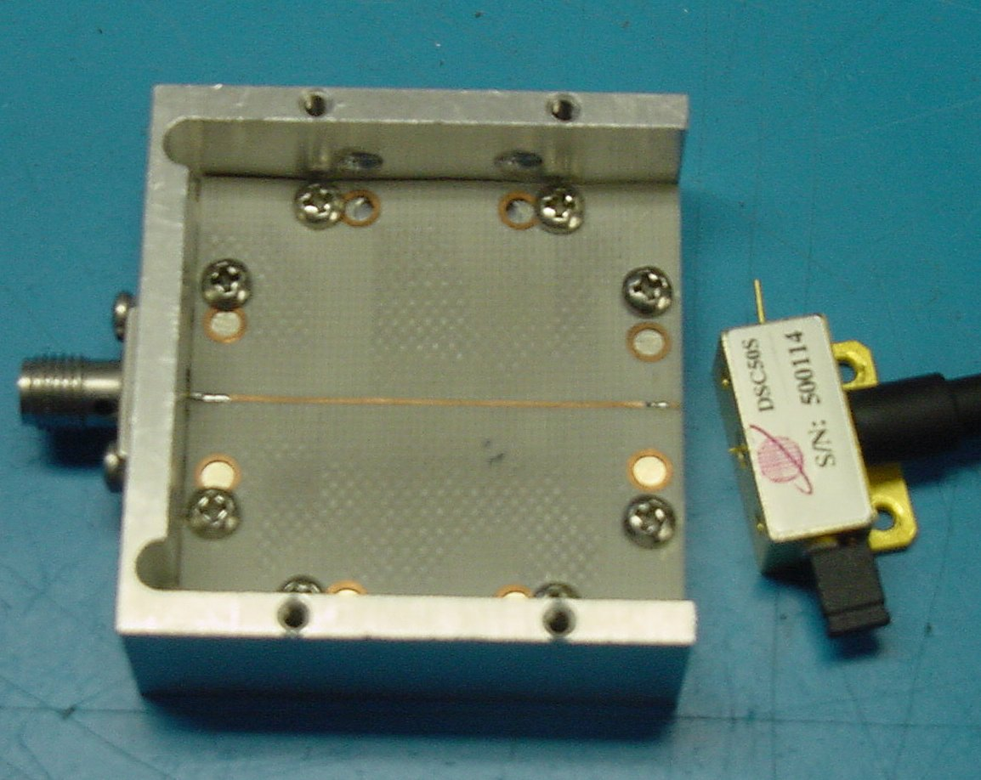
Testing of DSC50S Photodetector with
Sliding Tab Connector
DSC50S with
K connector
DSC50S with
Sliding tab and
Micro strip, PSI
modification
DSC50S with Sliding tab and
Micro strip, as is. (bad ground)

